Slide 1

Data Management and Database Design
Manisha Bahrani
Yash Kumar Bhaiya
Girija Dhawale
Devarsh Shah

Slide 2
Project Objectives
To ensure a continuous supply of materials and stock so that production should not suffer at the time of customers demand.
To maintain the availability of materials whenever and wherever required in enough quantity.
To maintain a systematic record of inventory.
To design proper organization for inventory management. Clear cut accountability should be fixed at various levels of the organization.

Slide 3
Business Rules
All primary keys in the table should contain 10 characters only - Check Constraint
First names and last name should only contain alphabets. Numbers or special characters are not allowed - Check Constraint
Delivery date cannot be prior to any given order date - Check Constraint
Price and amount cannot be set to zero, NULL or negative values - Check Constraint
Every customer bill must have a customer id reference.
Each order will have only one supplier.
A supplier can have one or more orders.
Each distributor can receive orders from one or more customers.
Each order should have one and only one invoice.
Each invoice may have only one order.
Each employee will belong to only one department.
Each department can have one or more employees.
Phone number is optional and can be NULL.

Slide 4
Entity Relationship Diagram

Slide 5
Implementation

Slide 6
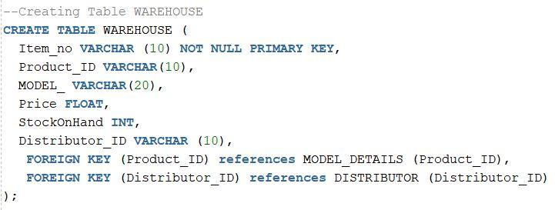
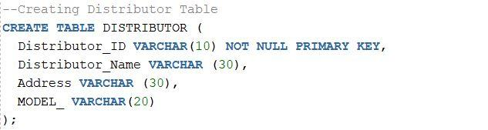
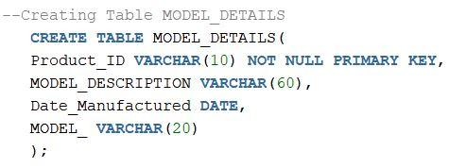
CREATE TABLE

Slide 7
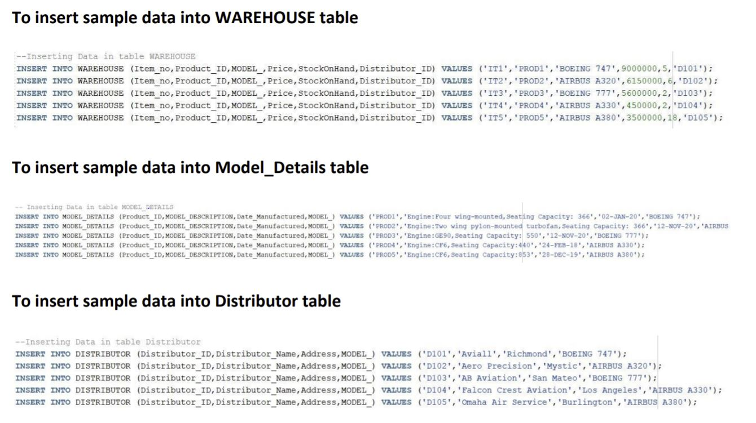
INSERT DATA

Slide 8
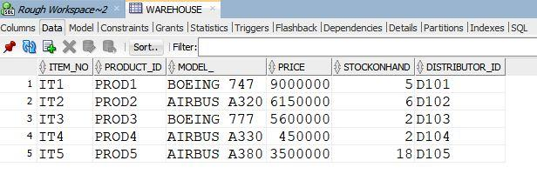
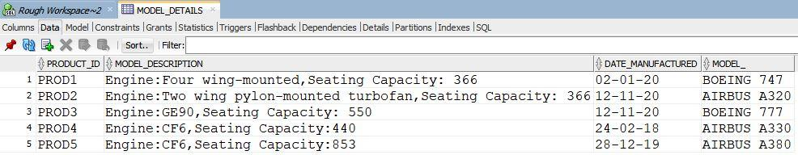
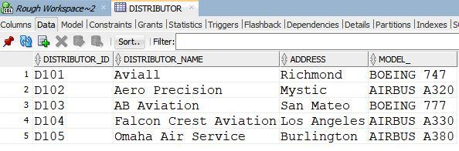
OUTPUT
DATA FOR WAREHOUSE
DATA FOR MODEL_DETAILS
DATA FOR DISTRIBUTOR

Slide 9
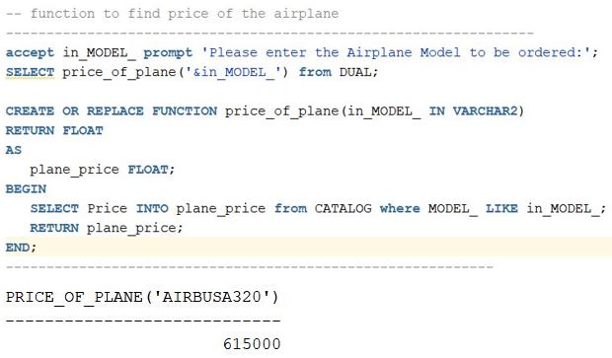
FUNCTIONS

Slide 10
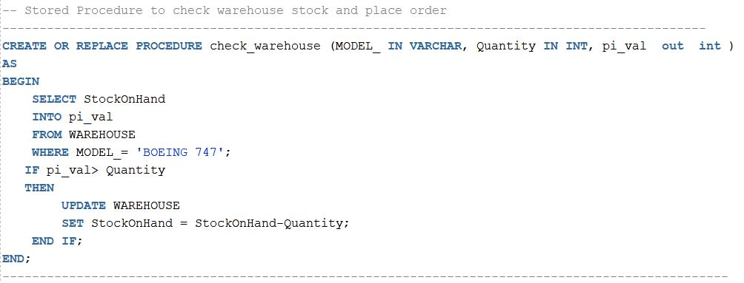
STORED PROCEDURE

Slide 11
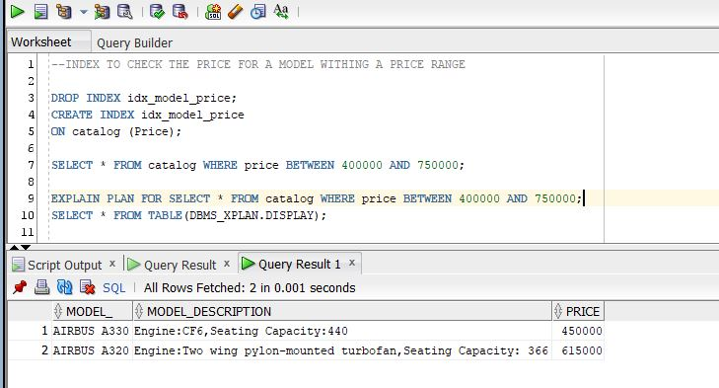
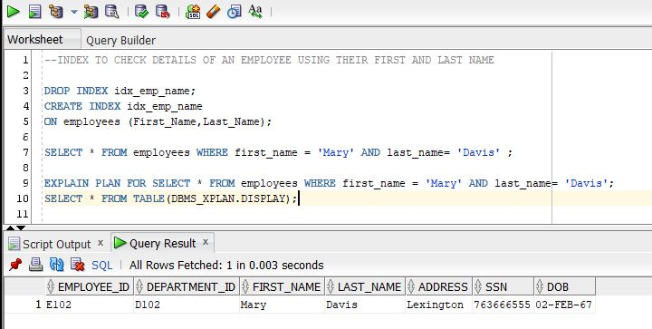
INDEX

Slide 12
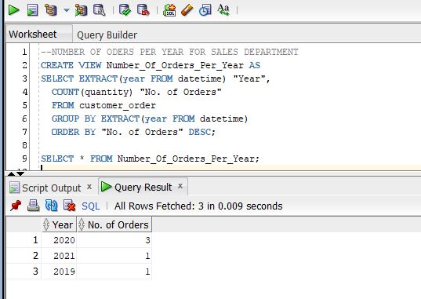
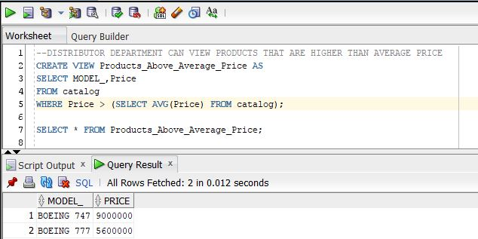
VIEWS

Slide 13
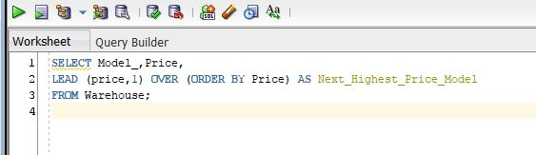
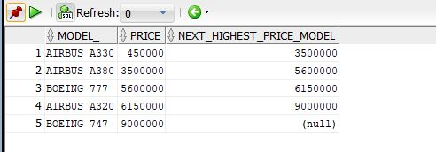
Reports

Slide 14
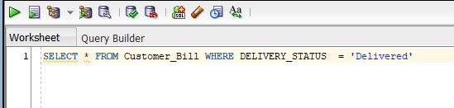
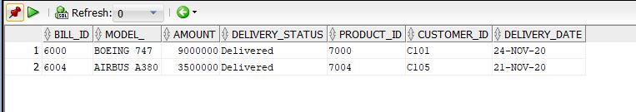
Reports

Slide 15
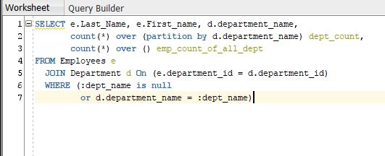
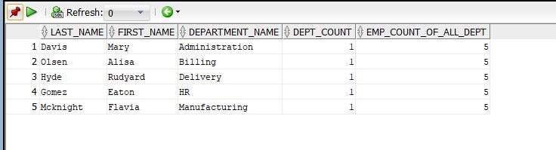
Reports

Slide 16
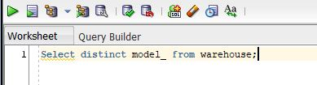
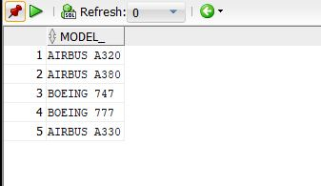
Reports

Slide 17
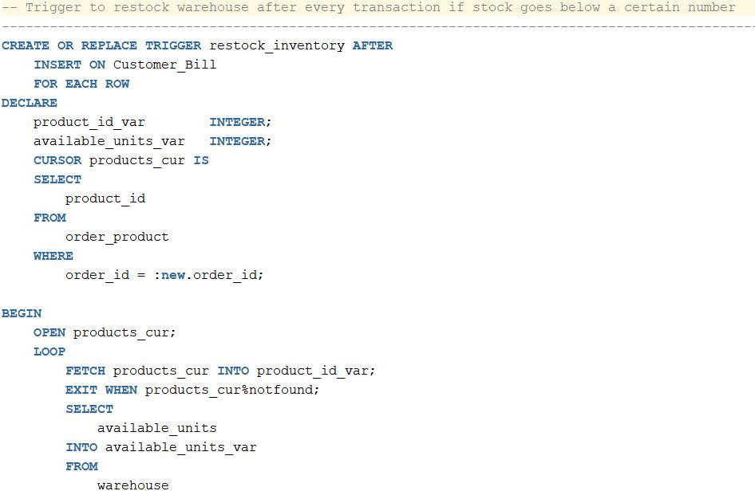
Trigger

Slide 18

Thank you

